Slide 1
Illinois Community College Board Strategic Plan for Adult Education and Literacy
January 16, 2018
Adult Education Strategic Plan Taskforce Meeting
Illinois Community College Board
Springfield, IL

Slide 2
Welcome and Introductions Dr. Karen Hunter Anderson

Slide 3
Purpose of the Meeting
Review the Activities of the Taskforce
Review the Vision and Guiding Principles
Review and consider the comments from the Public Forum
Review the four Goals and proposed Objectives
Next Steps

Slide 4
Activities:
Group Work between October 2017 and January 2018
Draft Adult Education Strategic Plan Released-January 5, 2018
Public Comment Forums
Webinar on January 9, 2018
Bloomington, IL – January 10, 2018
Palos Hills, IL – January 12, 2018
Written Comments – January 12, 2018

Slide 5
Strategic Plan Goals:
Goal #1- Improve Outcomes by Scaling Effective Models and Strategies Across the System
Goal #2- Increase Postsecondary Transitions and Credential Attainment
Goal #3- Strengthen College and Career Readiness
Goal #4- Develop life-long Career Pathway Systems & Enabling Technologies

Slide 6
Why develop a Strategic Plan for Adult Education?
There will be 55 million job openings in the economy through 2020:
24 million openings from newly created jobs
31 million openings due to baby boomer retirements.
Source: Georgetown University, Center on Education and the Workforce- Recovery Job Growth and Education Requirements through 2020.

Slide 7
The Importance of an Adult Education & Literacy Strategic Plan
By 2020, 65 percent of all jobs in the nation will require some postsecondary education and training beyond high school.
70% in Illinois
Only 34 Percent of Jobs Expected to Be Open to High School Graduates or less.
30% in Illinois
Source: Georgetown University, Center on Education and the Workforce- Recovery Job Growth and Education Requirements through 2020.
Notes:
23% of jobs will require a bachelor degree
11% of jobs will require a master’s degree

Slide 8
Illinois Adult Learners
1.1 million without a high school diploma
Approximately 2.8 million Illinois residents speak a language other than English as the primary language in their homes.
Approximately 350,000 immigrants reside in Illinois.

Slide 9
(1) assist adults to become literate and obtain the knowledge and skills necessary for employment and self-sufficiency; (2) assist adults who are parents or family members to obtain education and skills that- (A) are necessary to becoming full partners in the educational development of their children; and (B) lead to sustainable improvements in the economic opportunities for their family; (3) assist adults in attaining a secondary school diploma and in the transition to postsecondary education and training, including through career pathways; (4) assist immigrants and other individuals who are English language learners in- (A) improving their reading, writing, speaking and comprehension skills in English; and mathematics skills; and (B) acquiring an understanding of the American system of Government, individual freedom, and the responsibilities of citizenship.
PURPOSE OF WIOA - TITLE II:
Adult Education and Literacy Act

Slide 10
DRAFT ILLINOIS ADULT EDUCATION & LITERACY STRATEGIC PLAN

Slide 11
VISION STATEMENT

Slide 12
In partnership with other stakeholders, we will create learning opportunities that are aligned with statewide education, training, and employment strategies to ensure all adult learners have access to and success across services that are cohesive, coordinated, and innovative to promote better economic and sustainable career pathways.
Adult Education Strategic Plan Vision Statement 2018-2023

Slide 13
GUIDING PRINCIPLES

Slide 14
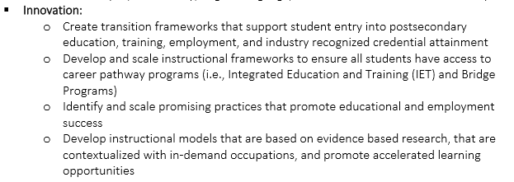

Slide 16
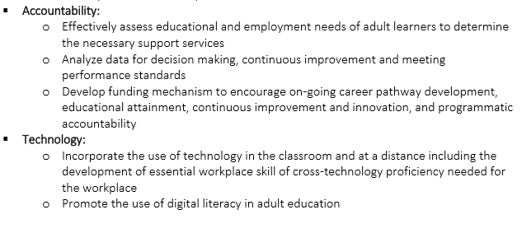

Slide 17
Plan Structure and Core Strategies

Slide 18
Adult Ed 2009-2014 Strategic Plan Focus
Great Recession and 11% unemployment
Middle-skills gap (unfilled openings)
Adult Education 2018-2023 Strategic Plan Focus
New Economy and 4% low unemployment
Job creation to college-educated
Broader "upskilling" for Future of Work
Career Pathways Development
Student access and support services
Scale Comprehensive Career Pathways
Integrated education and training - jobs focus

Slide 19
Illinois Adult Education and Literacy Draft Strategic Plan Goals & Objectives

Slide 20
Goal #1: Improve Outcomes by Scaling Effective Models and Strategies Across the System

Slide 21
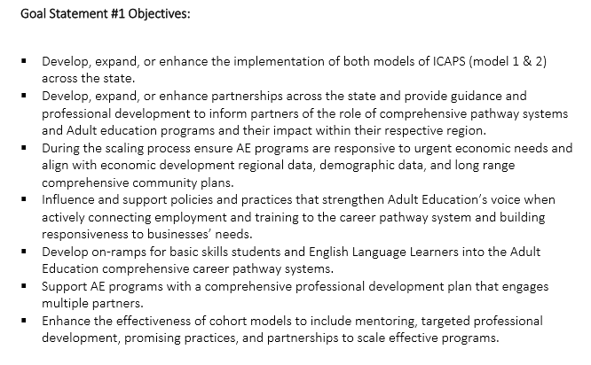

Slide 22
Goal #2: Increase Postsecondary Transitions and Credential Attainment

Slide 23
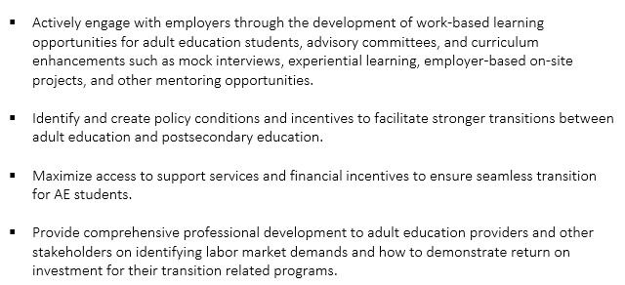

Slide 24
Goal #3: Strengthen College and Career Readiness

Slide 25
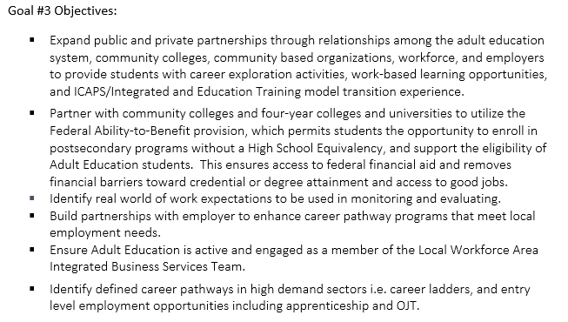

Slide 26
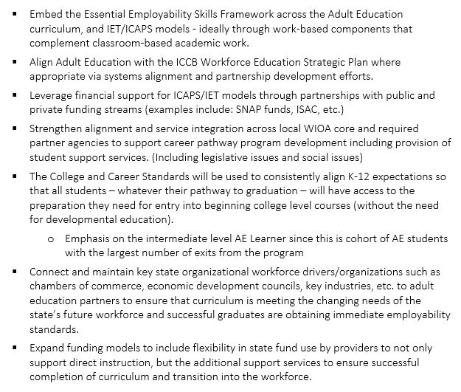

Slide 27
Goal #4: Develop Life-long Career Pathways Systems & Enabling Technologies

Slide 28
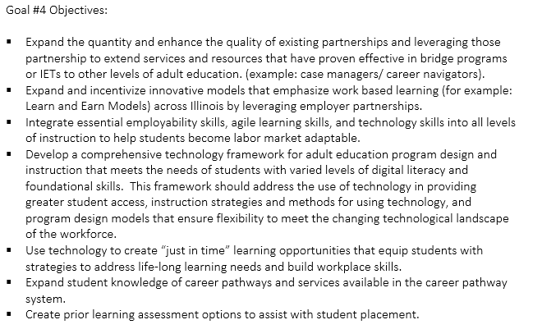

Slide 29
KEY OUTCOMES & NEXT STEPS

Slide 30
Final Version to Taskforce Members on January 23, 2018
Final Comments due January 26, 2018 at 12:00 noon
Submit the Adult Education & Literacy Strategic Plan to the Governor and General Assembly - January 31, 2018
_____________________________________________________
Development of Action Steps –Feb-April 2018

Slide 31
Questions and Comments

Slide 32
Additional Questions
Contact:
Jennifer Foster, Deputy Director for Adult Education and Workforce
Jennifer.Foster@illinois.gov

